Slide 1
MEDICATION WASTE REDUCTION
Data Driven Decision Making & Optimization
Professor: Carol J. Cagle
Team 2
Ravi Bandi
Khanh Dang
Hien Do

Slide 2
Obstacles
Planning
Wastage of medication (CSPs)
Dispensing
Communication
Notes:
Less efficiency in planning, communicating, and dispensing of CSP result in wastage of medication.
Annual waste of 47 thousand doses, and more than half a million dollars not including labor cost, disposal cost.

Slide 3




Partners
Health Care providers
Patients
Receiving medications & treatments
Diagnose condition, Order CSPs, Cancellations
Pharmacist
Technicians
Check and verify CSP order
Creation and delivery of CSPs

Slide 4
Goals
CSP preparation batch
Waste Disposal
Propose new CSP preparation batches to reduce medical waste
Reducing medical waste also saves disposal costs
Reducing errors in delivery
Minimizing communication gap
Reduce incorrect delivery of drugs to destination to minimize re-dispensing of drugs
Implementing double checks and CPOE system
Notes:
Computerized provider-order entry systems

Slide 5
Brainstorming
The number of doses prepared are also the doses that are enough for a day
CSPs are prepared one day prior
$140,541*
83-85%
Short expiration time, should be aware to prepare number of doses for future use in the current batch model. So, we are assuming CSPs are good for 2 days *
Duration between doses with start and final time helped us identify when and how many doses must be administered.

Slide 6
Brainstorming
Time of dose
New 24*7 three batch model
Time of cancellations
Confirmation of medicine

Slide 7
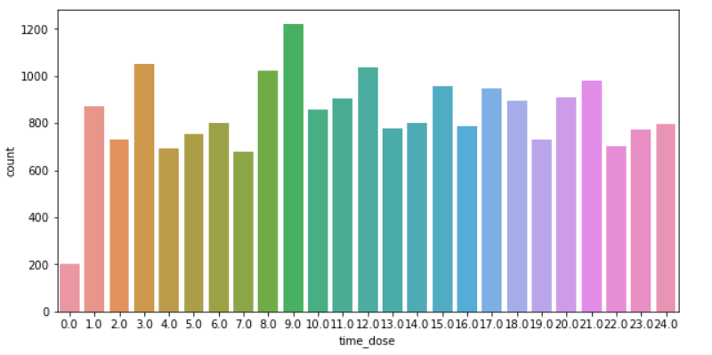
Brainstorming Dosage time
Medicine induction even through out the day

Slide 8
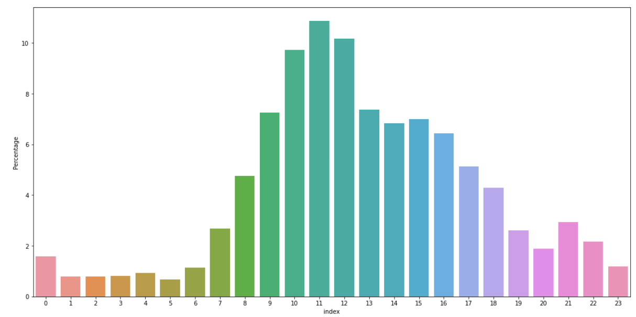
Brainstorming Cancellations
90% from 7 AM to 7 PM
Day time consultation hours

Slide 9
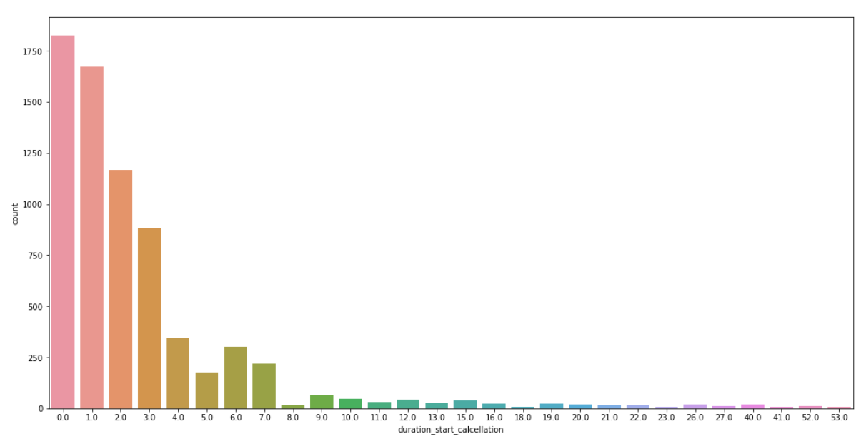
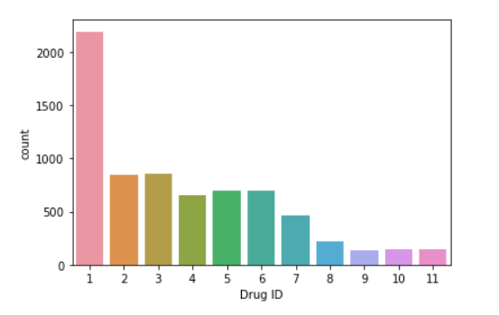
Brainstorming Medicine Confirmation & Drug ID
95% of medications are changed in first week
It takes time to confirm right medication
The drug ID 1 has the highest probability of cancelled

Slide 10
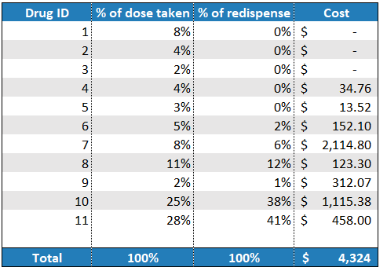
Brainstorming cost of Re - dispense
Drugs 10 and 11 are most misplaced drugs
Drug 7 is re-dispensed only 6% but cost highest

Slide 11
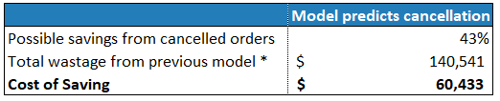
Action Plans: New Batches Model
6 AM
2 PM
10 PM
2 PM
6 AM
2 PM
10 PM

Slide 12
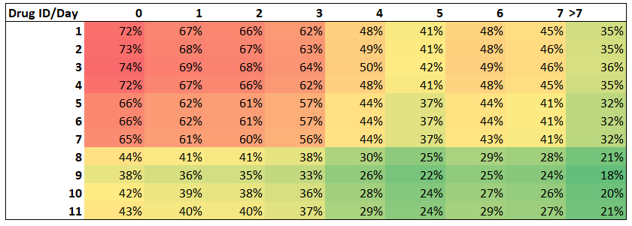
Action Plans: New Batches Model
Three batches 24*7 model where medications that are commonly cancelled within first week

Slide 13
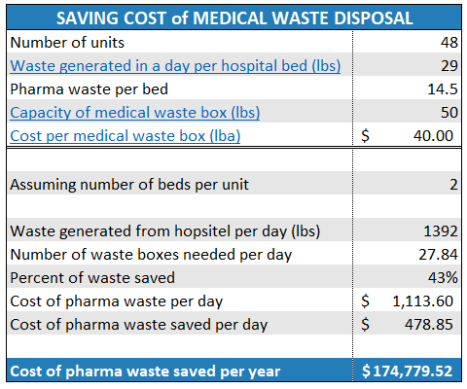
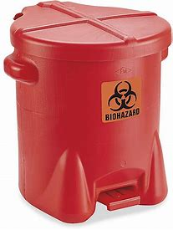
Action Plans: Medical Waste Disposal
Save $174K per year

Slide 14
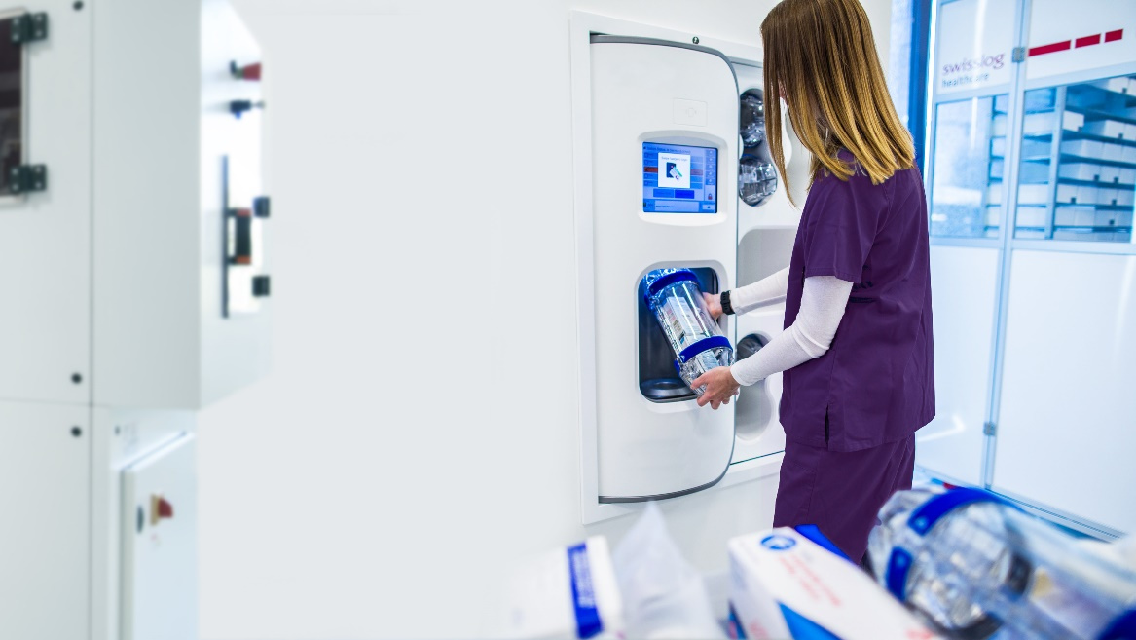

Action Plans: Minimizing Re-dispense
In previous model we were using pneumonic tubes for first dose only
In new model we use this system for all medicines except those which does not fit, rest of medicines and IV bags are dispensed thorough smart carts
Usage of color coding and destination nomenclature can also help

Slide 15
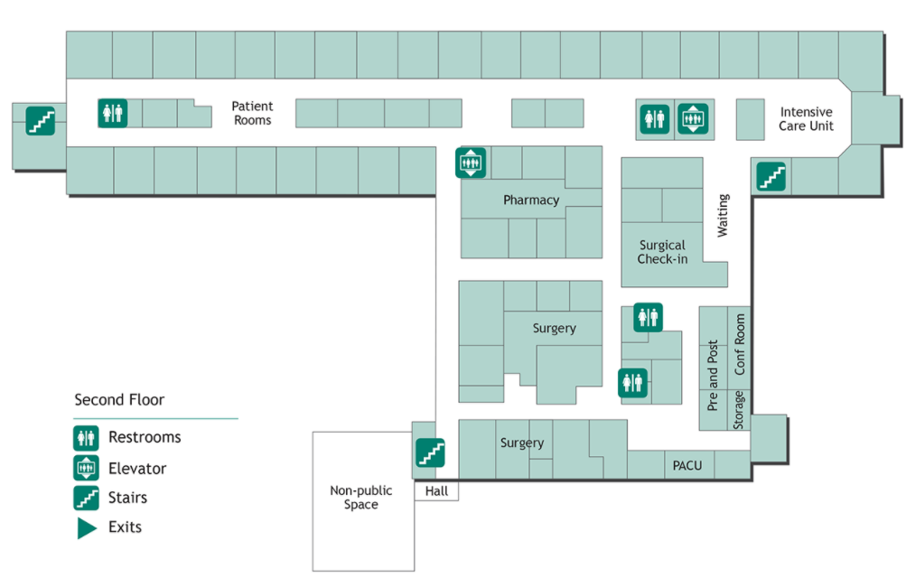
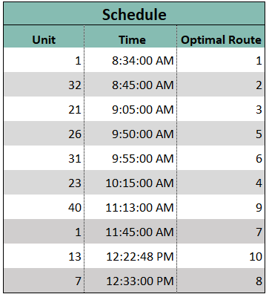
Action Plans: Smart Cart dispensing
9
13
21
23
26
28
8
7
1
40
32
31

Slide 16
Action Plans: Miscommunication
Label generation
CPOE system
Training Staff
Systems seek to eliminate errors resulting from handwritten and verbal orders
Reduce miscommunication
Consensus on common practices to avoid common errors

Slide 17
Savings
$62,811
$174,779
Savings from new model *
Probable wastage disposal savings per year
Total Waste from cancellations and redispense*
Probable yearly wastage disposal
$144,865
$406,245

Slide 18
THANK YOU

Slide 19
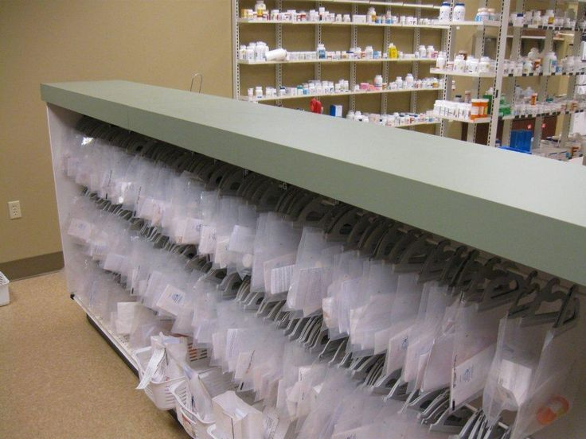
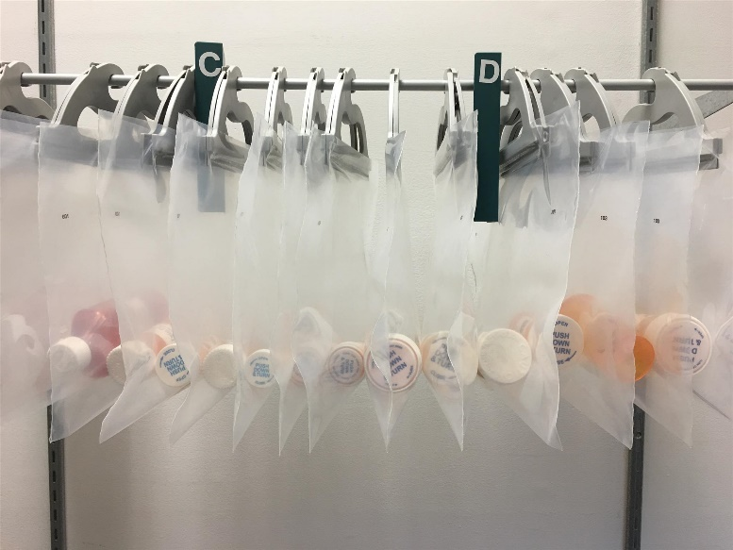
Appendix
References
Kyle A Weant, Abby M Bailey, and Stephanie N Baker (2014), “Strategies for reducing medication errors in the emergency department”, https://www.ncbi.nlm.nih.gov/pmc/articles/PMC4753984/, Published online 2014 Jul 23. doi: 10.2147/OAEM.S64174
Rama P. Nair, RPh; Daya Kappil, RPh; and Tonja M. Woods, PharmD (2010), “10 Strategies for Minimizing Dispensing Errors”, https://www.pharmacytimes.com/publications/issue/2010/January2010/P2PDispensingErrors-0110

